Slide 1

China’s Changing Demographics
Yong Cai
caiyong@unc.edu
Department of Sociology and Carolina Population Center
University of North Carolina at Chapel Hill
2017 TEACHERS WORKSHOP
Redwood City, July 27, 2017

Slide 2
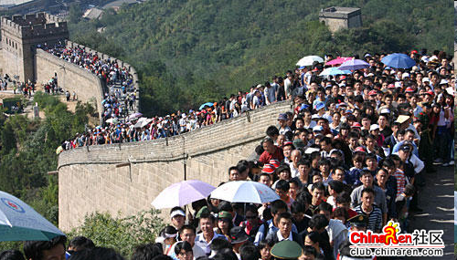

Slide 3
Outline
China’s main demographic features
The one-child policy and low fertility in China
China’s main demographic challenges and policy implications

Slide 4
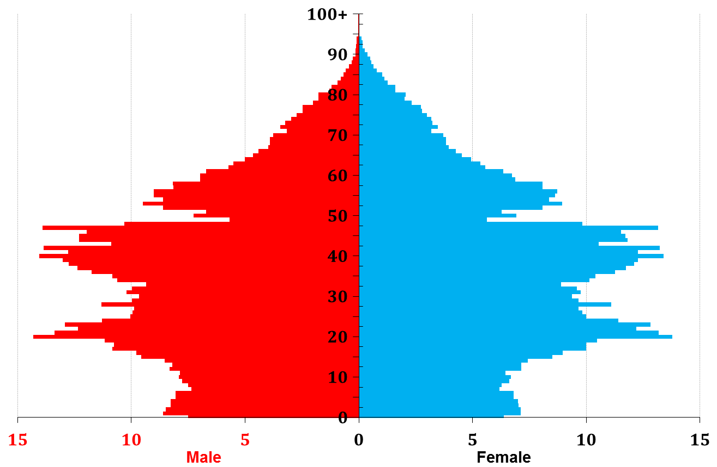
Population is a history book:
China’s population sex-age structure 2010 (Census)
More males than females except the oldest
Baby boom after revolution
1959-61 Famine
1971: later, longer, fewer
1980: one-child
Echo
Low fertility
millions

Slide 5
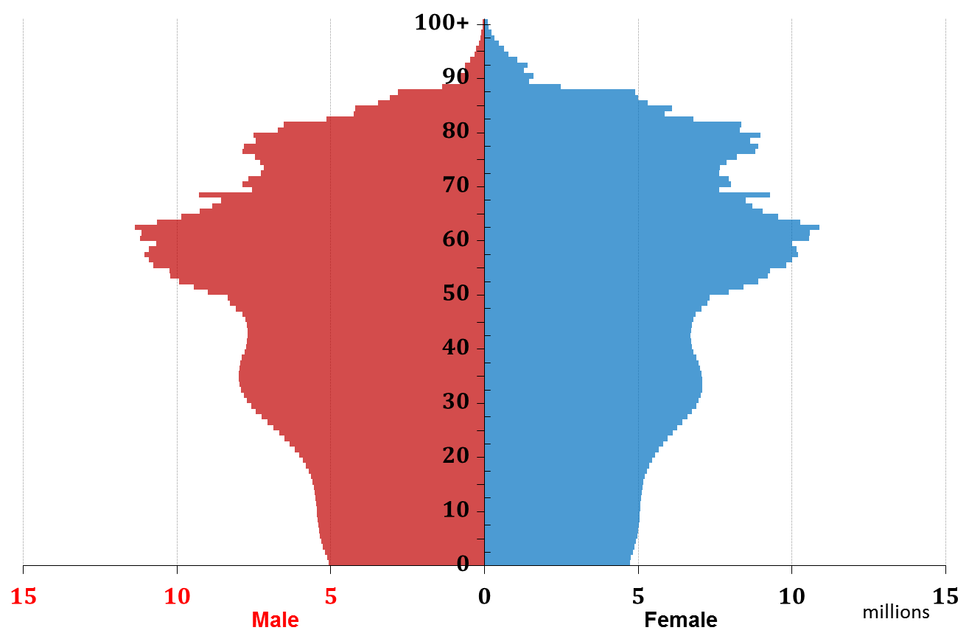
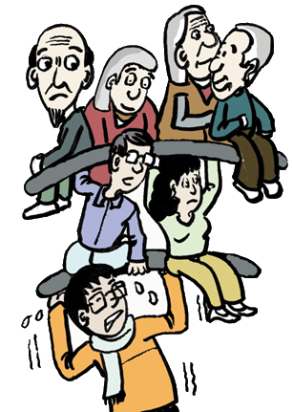
“Demography is destiny”:
China’s population sex-age structure 2050 (Projection)
? Low fertility?

Slide 6
China’s route to low fertility
1971 “Later, Longer and Fewer” Policy
1991 “One-veto” Policy
1992 Market Liberalization
1959-61 GLF Famine
1978 Economic Reform
1980 “One-child” Policy
Notes:
6

Slide 7
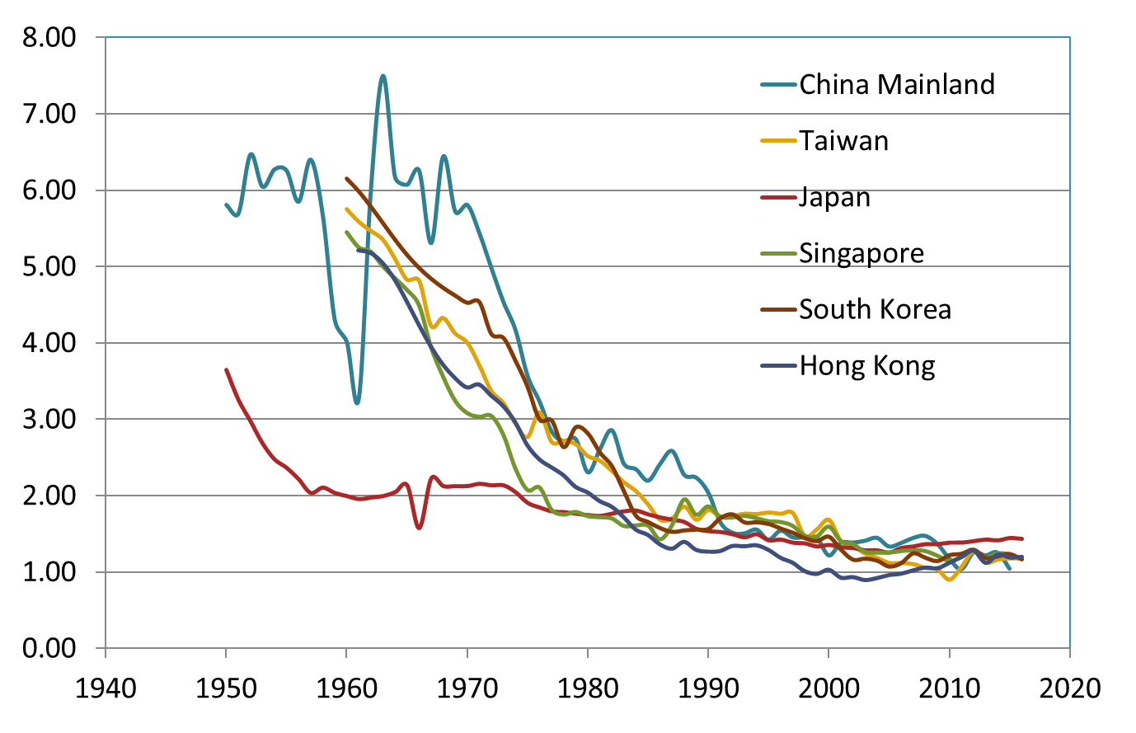
Fertility: China and neighboring regions

Slide 8
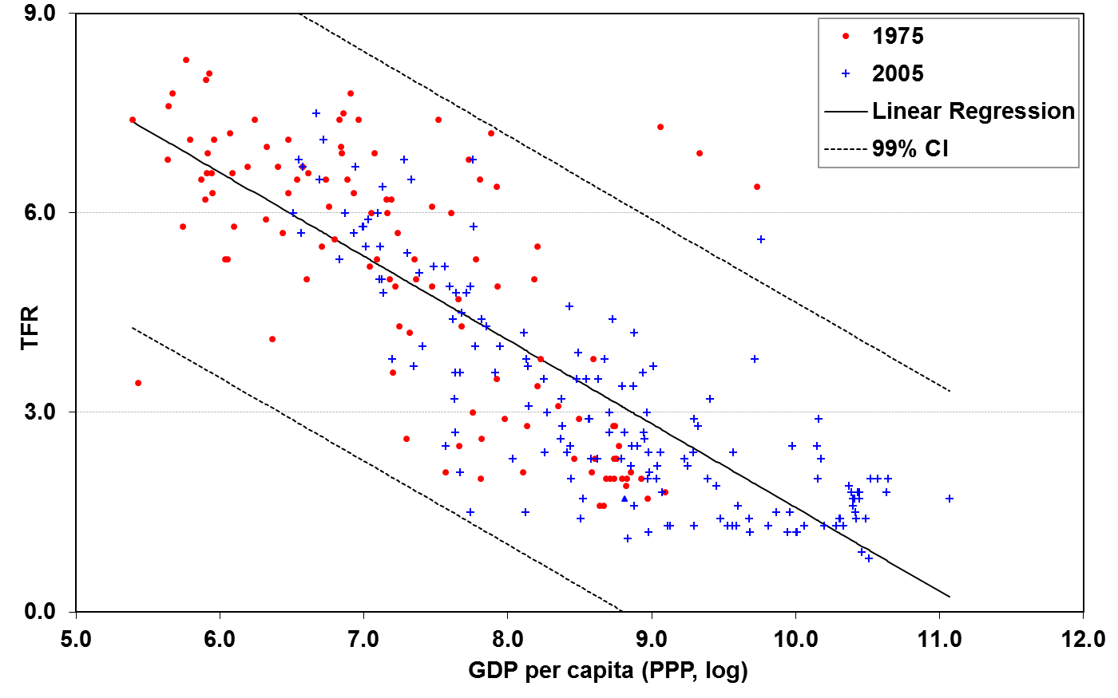

“Development is the best contraceptive”
Saudi
Kuwait
UAE
Equatorial Guinea
TFR=14.16 – 1.26 *ln(GDP)
China, 1975
China, 2005

Slide 9
Fertility decline, China and selected few
Data Source: World Bank WDI (Smoothed by World Bank).

Slide 10
The One-child Policy
Motivation: quadruple GDPPC from $250 to $1,000 in 20 years.
    The population must be limited to 1.2 billion by 2000.
    The only way to achieve this goal was “one child per couple.”
Justifications for unusual measure
    Large population is an obstacle to economic development
    Cultural preference for large family and male descendants
    Labor needs in an agriculture-based economy
    Temporary collective sacrifice for collective goods
Almost a “perfect” policy?
  Articulated motivations and clear goals
  Fair and transparent
  Government commitment
  Social mobilization
  International support
Implementation: resistances and modifications -- about two-thirds of all Chinese population lived under the one-child rule circa 2000 (Policy TFR= 1.47)

Slide 11
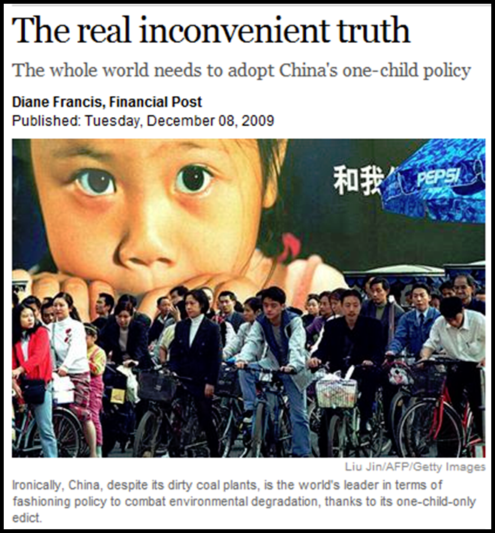
Was it a Success?
Chinese government: reduced births by 400 million.
  A major factor behind China economic success.
  China’s contribution to the battle against the global warming
September 20, 2014

Slide 12
Critics: an unnecessary and failed policy
China’s fertility was already low before the policy, TFR=2.7. Fertility decline is not unique to China. The 400 million number is a total exaggeration.
The policy was based on false assumptions, pseudo-science.
  The policy was a failure by its own measure: Chinese population was 70 million more than its controlling target (1.2 b) in 2000.
  The extra 70 million did not hinder economic development
  “Science” focused on wrong indicators
  Chinese always want to have as many children as possible? Current ideal family size = 1.7, many are forgoing of their opportunities to have a second child.
A blunt violation of reproductive rights, with tremendous social costs. It has created more problems than it tries to solve: flood of abortions, rapid aging, sex imbalance …
Notes:
Human Impact (I) on the environment equals the product of P= Population, A= Affluence, T= Technology.

Slide 13
The ending of the one-child policy
Three step process:
  March 2013: merging the National Population and Family Planning Commission with the Ministry of Health to create a new National Health and Family Planning Commission.
  November 2013: a partial policy relaxation that allowed couples to have two children if one parent is an only child.
    Among the estimated more than 11 million couples eligible under the new rule, only 1.69 million had applied as of August 2015, and only about a third of its applicants had a second child so far.
  October 2015: to allow all couples to have two children in 2016.
Population policy making in China
  Political decision: a top-down authoritarian political system
  Utilitarian approach: for the purpose of economic development
  Statist tradition: one size fits all

Slide 14
Unmistakable parallels
 | Making (1979/80) | Scrapping (2014/15)
New Political Leadership | Deng | Xi
Economic Challenges | Shortages: capital, resources… | Slowdown, inequality
Demographic Challenges | Rapid growth | Structural imbalance
Global Population Discourse | Population Bomb | Aging, Low Fertility Trap
Policy Goals | Short term: slow down growth Longer term: reduce population size (?) | Short term: stimulate consumption Longer term: labor supply, aging …
Immediate Effects | Small drop in fertility in 1980 | Small increase in fertility in 2016
Long term Effects | Limited directed effects on fertility, but more profound on social/political… | ? Unlikely to boost fertility in major way

Slide 15

“Demography is destiny”:
China’s population sex-age structure 2050 (Projection)
Low fertility

Slide 16
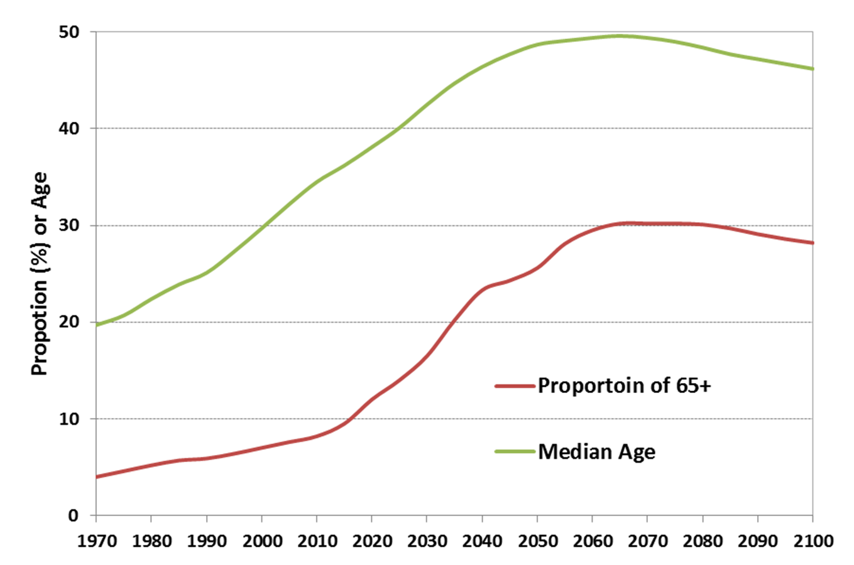
UN’s Projection: Aging

Slide 17
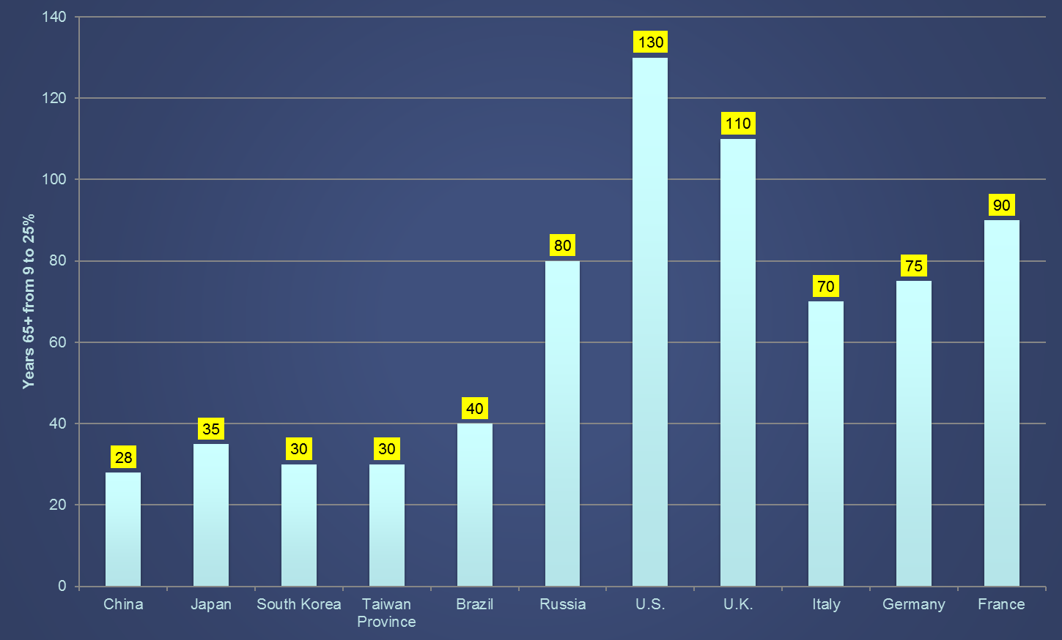
Pace of Aging, Years 65+ from 9% to 25%

Slide 18
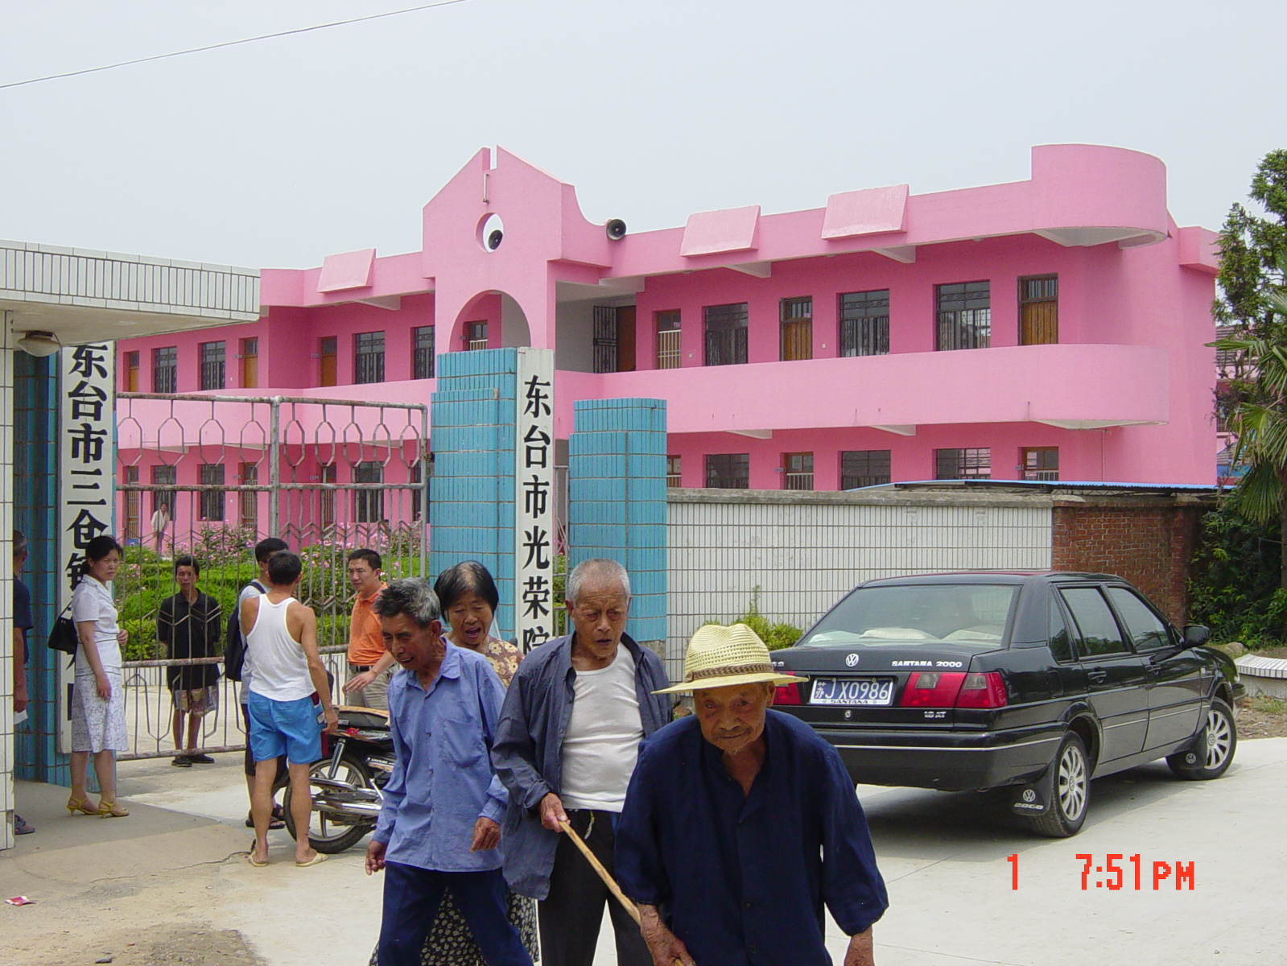
The Future of China’s Population

Slide 19
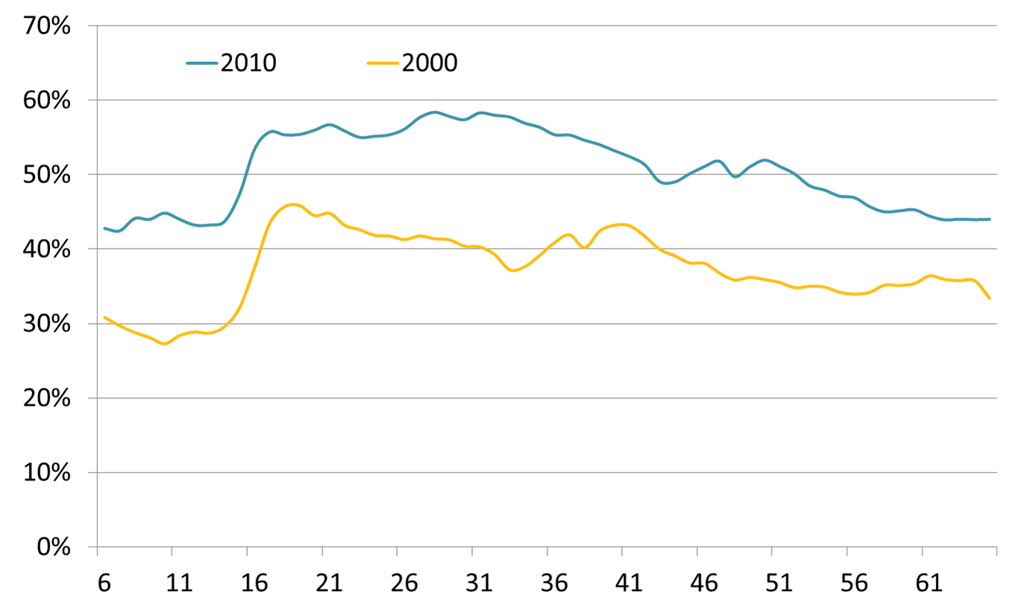
Urbanization, aging, and left-behind Children
Urbanization: 37% to 51% in 10 years, about 20 million a year, driven largely by labor migration, Hukou is still a barrier

Slide 20
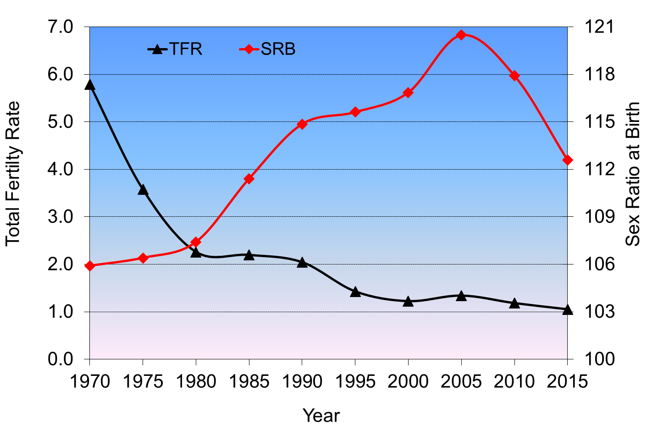
Fertility and Sex Ratio at Birth

Slide 21
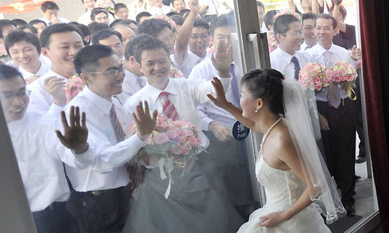
Gender Imbalance

Slide 22
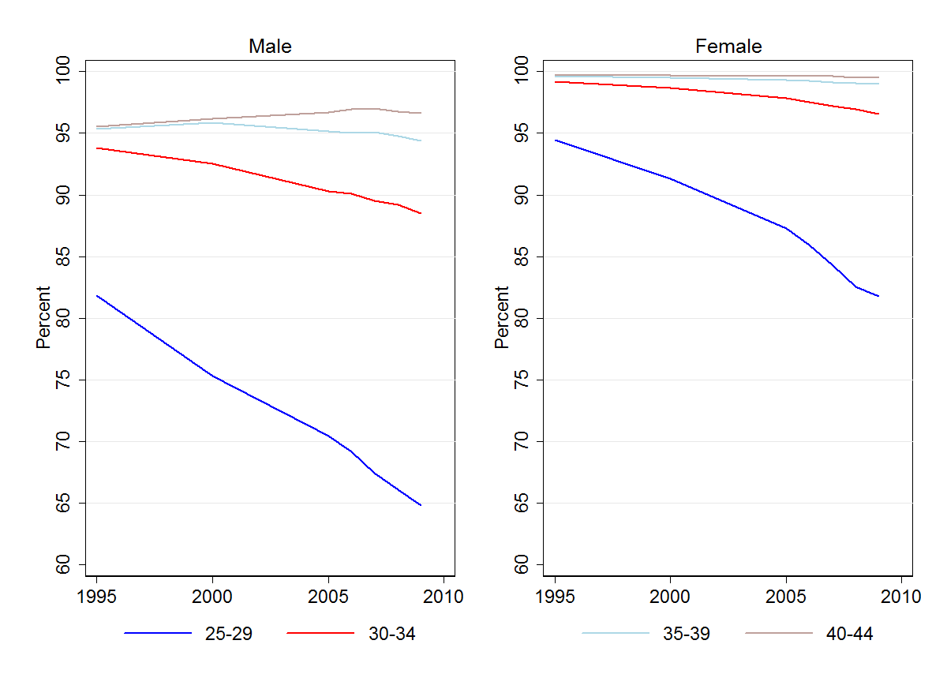
Proportion of Ever Married by Sex and Age, China

Slide 23

Forbes: The World's 56 Self-Made Women Billionaires
Country Breakdown:
  21 in China (37.5% of the list)
  17 in the United States (30%)
  5 in Hong Kong
  3 in the United Kingdom

Slide 24
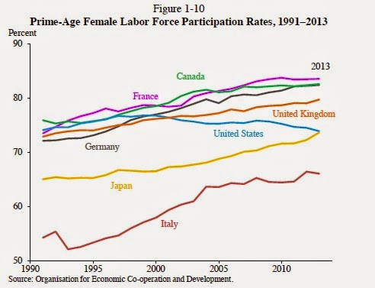
China

Slide 25
What goes from here?
Basic demographic features
  Fertility: Sustained low fertility, risk of “low-fertility trap”
  Mortality: declining mortality
  Migration: Rapid urbanization
  Demographic “momentum”: rapid aging
Demographic dividend → Demographic burden
Reform dividends:
  Urbanization (Hukou reform)
  Investment in education/human capital
  Social welfare reforms
Challenges: Social inequality / government capacity

Slide 26
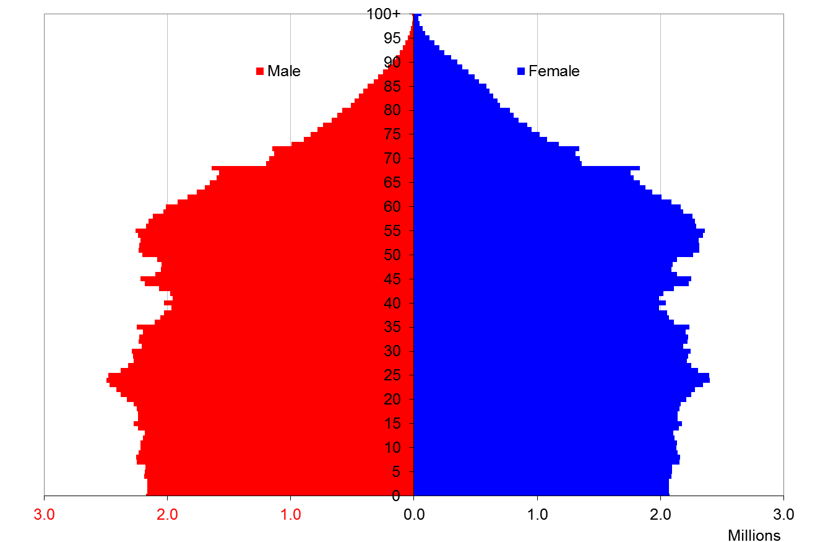
Reading the History: Population Pyramid, U.S. 2015
Notes:
http://www.ined.fr/jeux.php?_movie=chargement.swf?_movie=simulateur.swf&lg=en&titre=Population%20simulator&lg=en&jeu=ok

