Slide 1
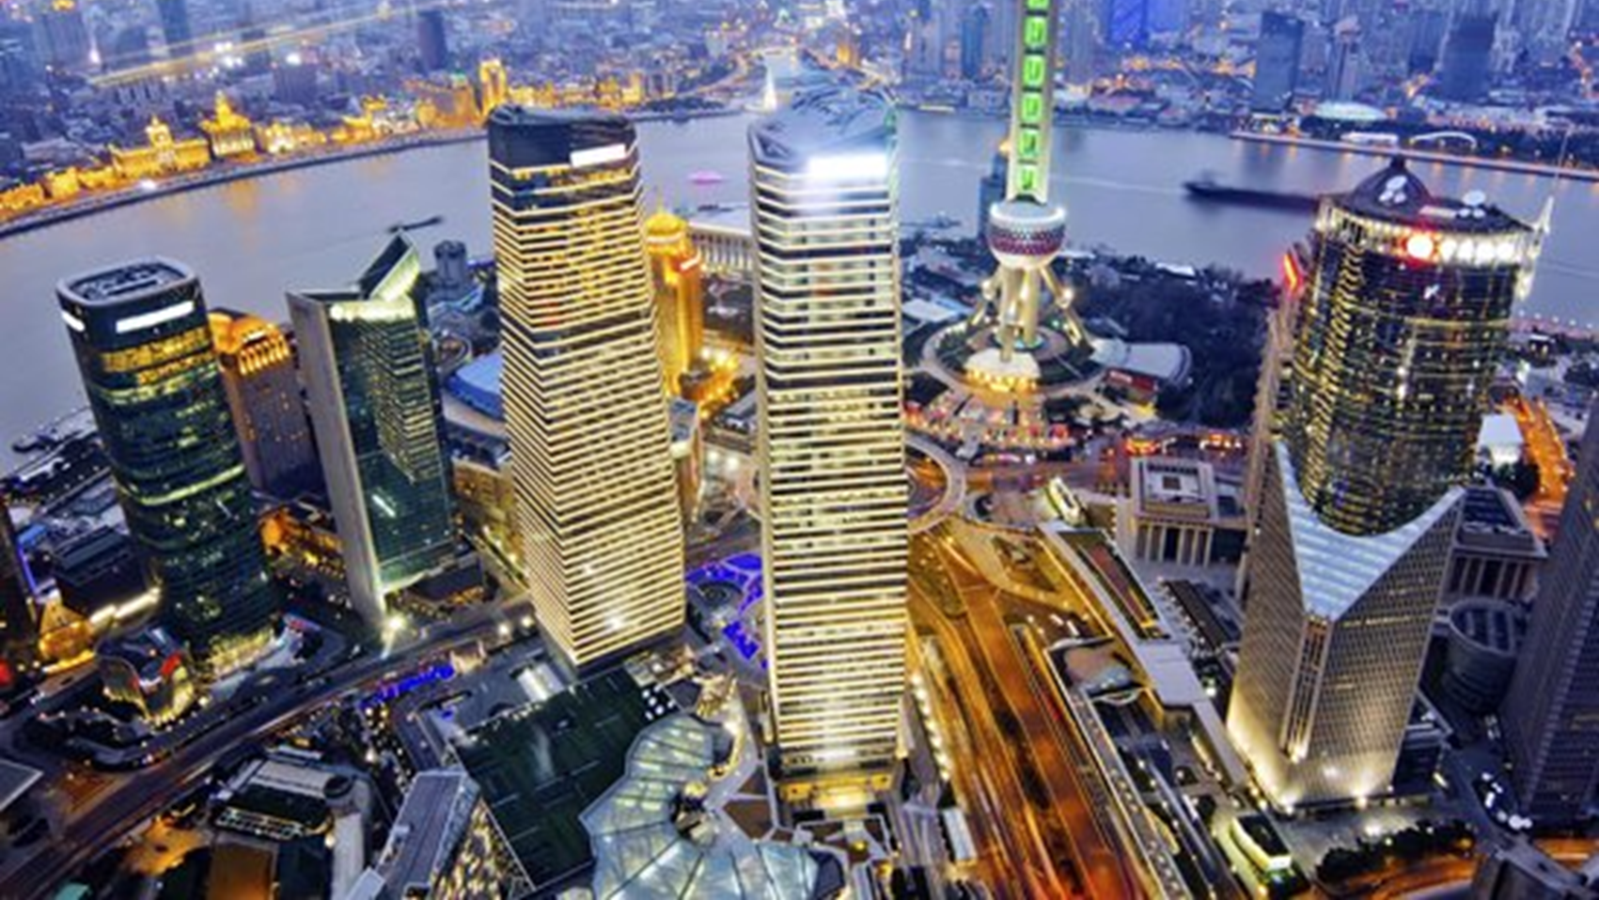
Glimpse of a Chinese millennium’s life
Mengping Li
July.28, 2018

Slide 2
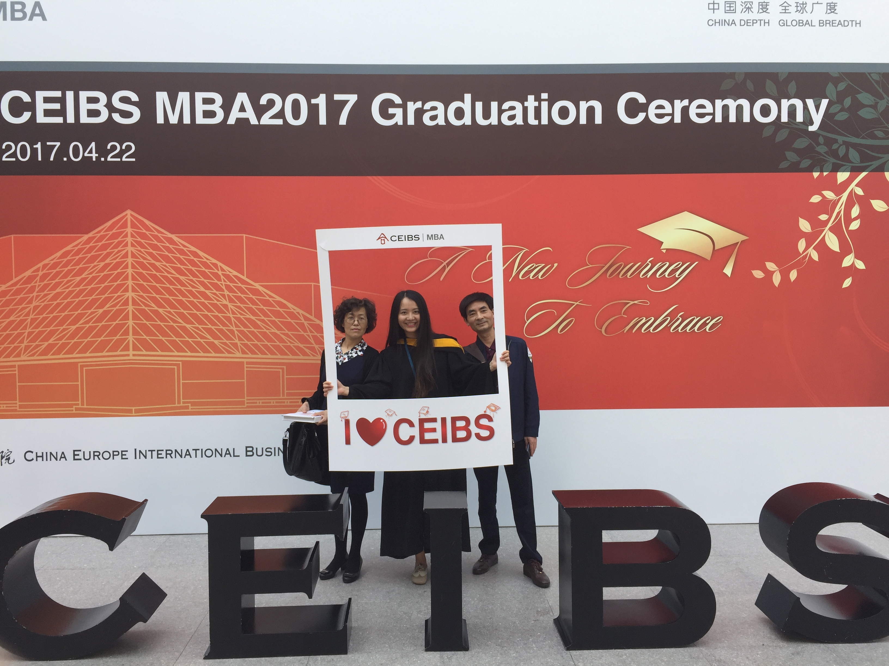
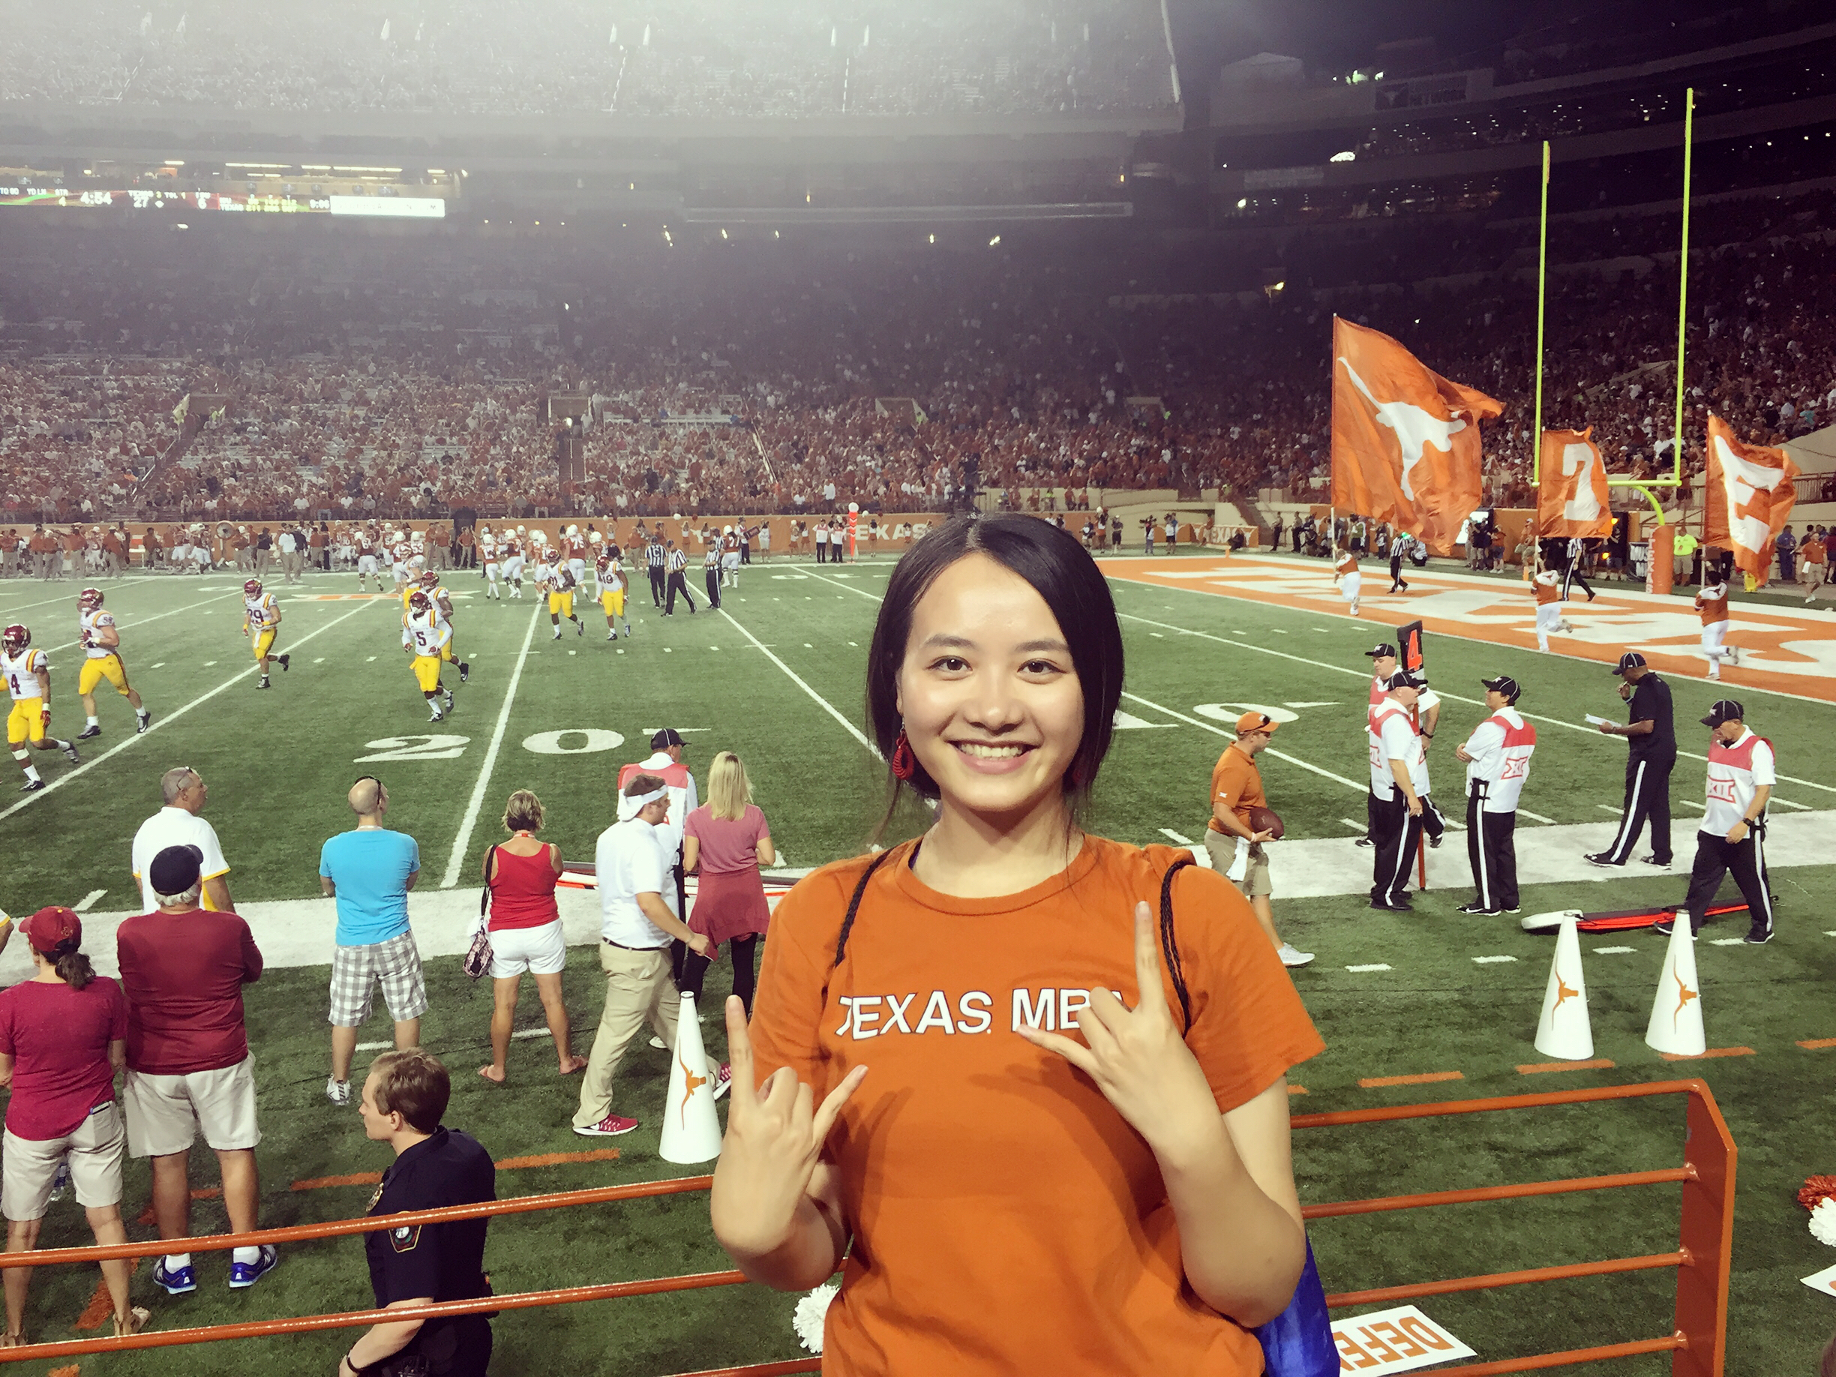
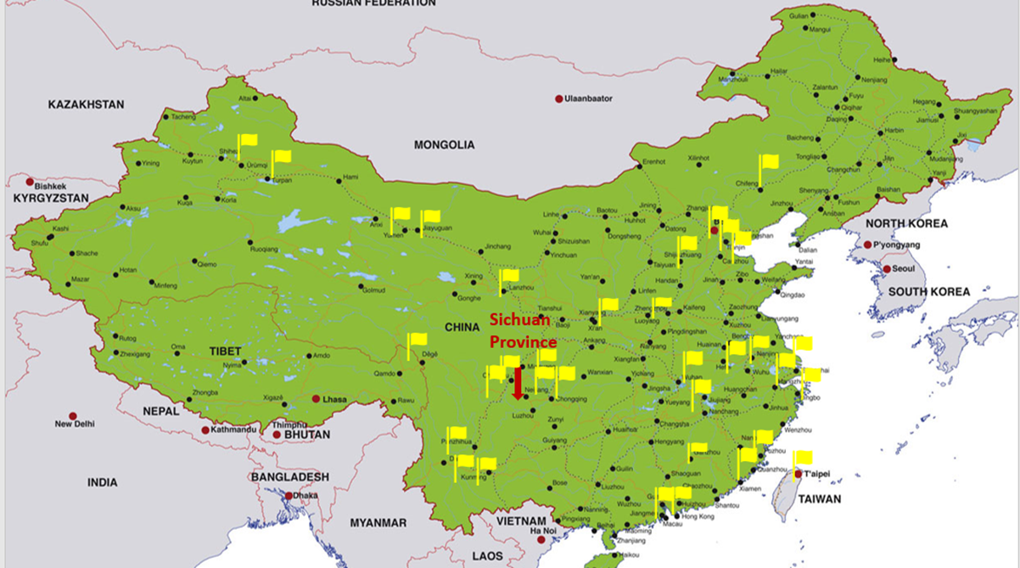
Meng(Dream)Ping(Peaceful) Li
Professional Life:
Microsoft Beijing, Digital Lead
Project Management @ Beijing Genomics Institute
Service Sales @GE Healthcare
Education:
Traditional Chinese Medicine Translation in Chengdu
CEIBS MBA in Shanghai
A Life & World Explorer
  Humble beginnings: Southwestern China
  Traveled within China in 6 years
  15 countries in 2015~2018

Slide 3
Rapid Changes in China
1

Slide 4
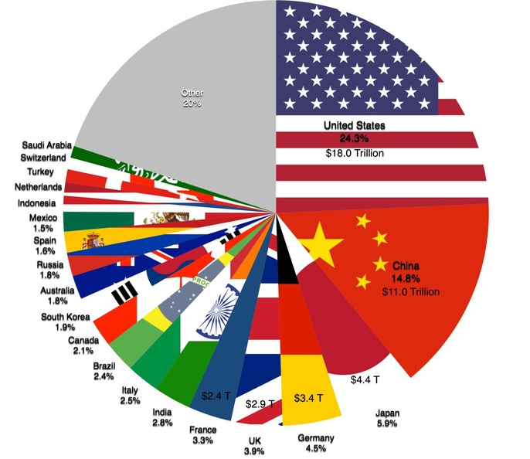
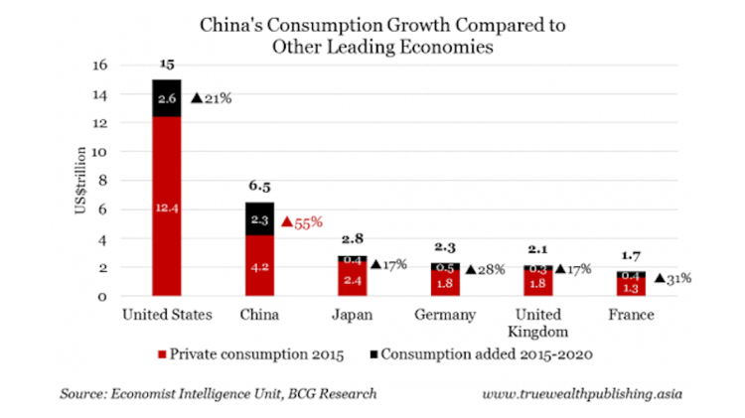

Rising Purchasing Power
The 2nd Largest Economy
The 2nd Largest Consumption Power
115/500 Chinese Companies
Sources： World Economy
China's Exploding Middle Class

Slide 5
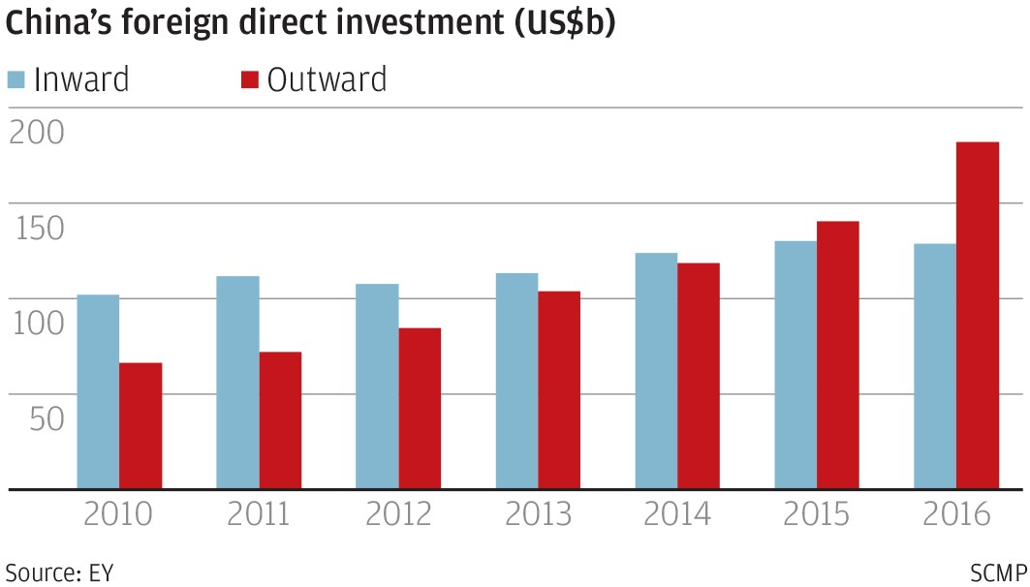
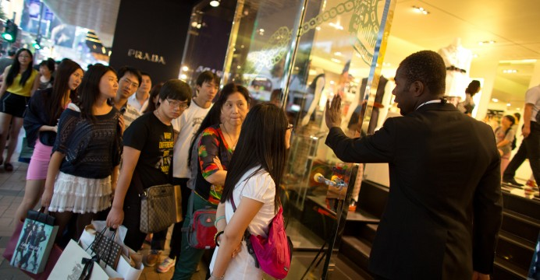
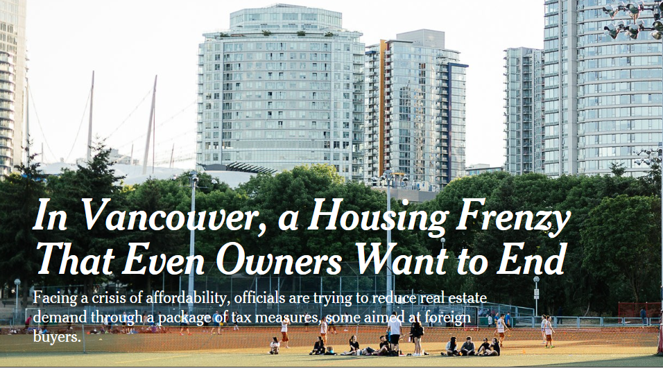
Rising Purchasing Power
Buy! Buy ! Buy!
Sources： Business Insider
Notes:
https://www.nytimes.com/2018/06/02/business/economy/vancouver-housing.html

Slide 6
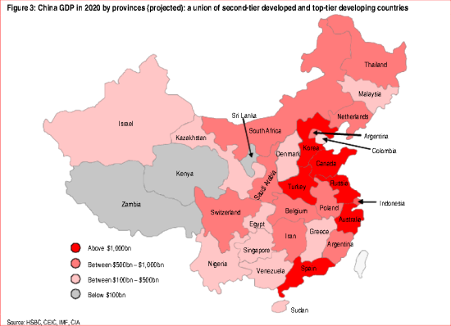
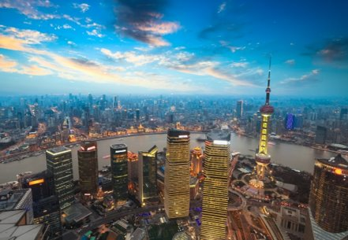
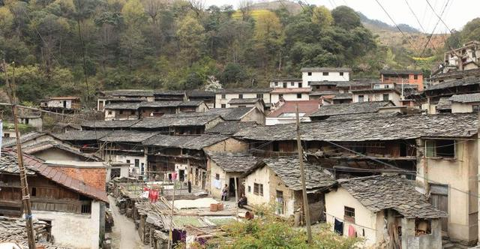
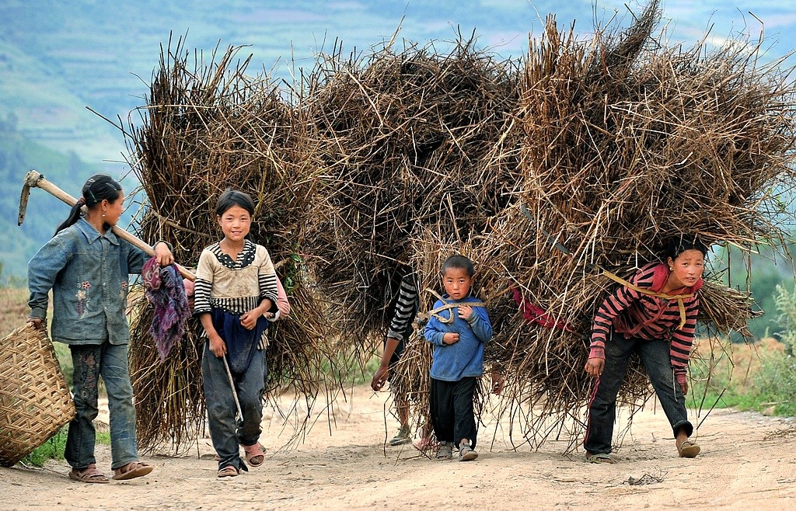
Behind the Rapid: Uneven
First Tier Cities(Beijing, Shanghai, Guangzhou, Shenzhen) only occupies 5% of total population
Rural population occupies 41% of total population
China National Statistics Bureau
Sources ：GDP project
Notes:
China's projected GDP by province (for 2020). (Source: HSBC, CEIC, IMF, CIA)

Slide 7
China is rising in an unevenly development way.
A very dynamic Market.

Slide 8

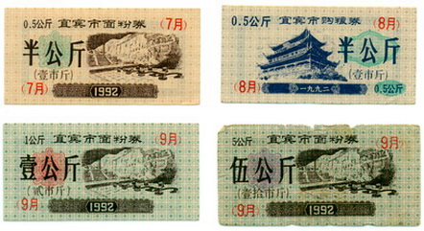
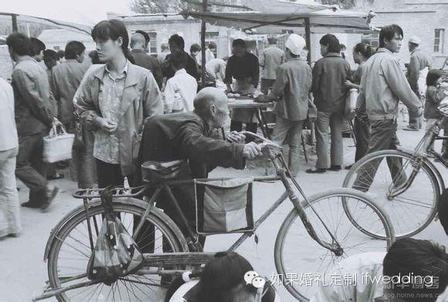
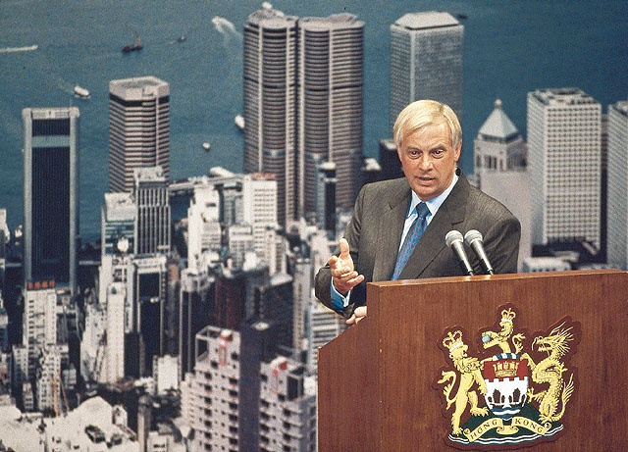
In 1992, when I was 3 years old.
Beijing
Hongkong
Taiwan
GDP Per Capita $ | 1992 | 2017
Mainland China | 366 | 8,836 24X
Taiwan | 10,000+ | 23,940
Hongkong | 17,976 | 45,847

Slide 9
Taiwan, Hongkong, Mainland China are different.

Slide 10
China is moving online
751 million Internet Users
724 million Mobile Internet Users
96.3% are surfing online
Internet Users
751m
PRC Total Population 1.379b
Mobile Internet Users 724m
Internet Users
290m
US Total Population 325.6m
89%
Data source: US Census Bureau, CNNIC, Internet Live Stats Aug 2017
Credit Card Penetration in US and China, 2016, M
502million mobile payment users
Life without wallet
Source: US Census Bureau, Reuters, Jul 2017
Mobile Payment in China, 2013 – 2017E, $T
In past 5 years, 11.02 trillion mobile payment transaction volume
Source: Analysys, Jul 2017

Slide 11
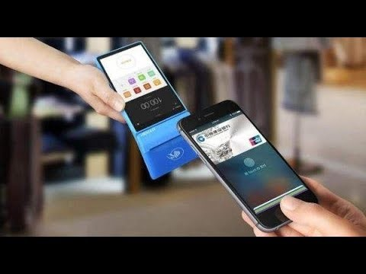
Mobile Life
Notes:
https://www.youtube.com/watch?v=deuasCuyrbM&feature=youtu.be

Slide 12
Opportunities for a young woman from a small county
2

Slide 13
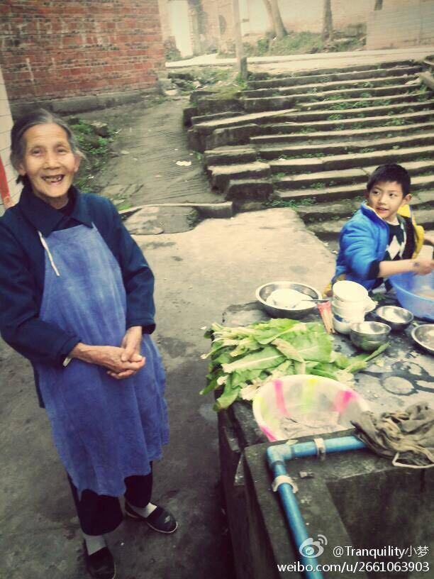
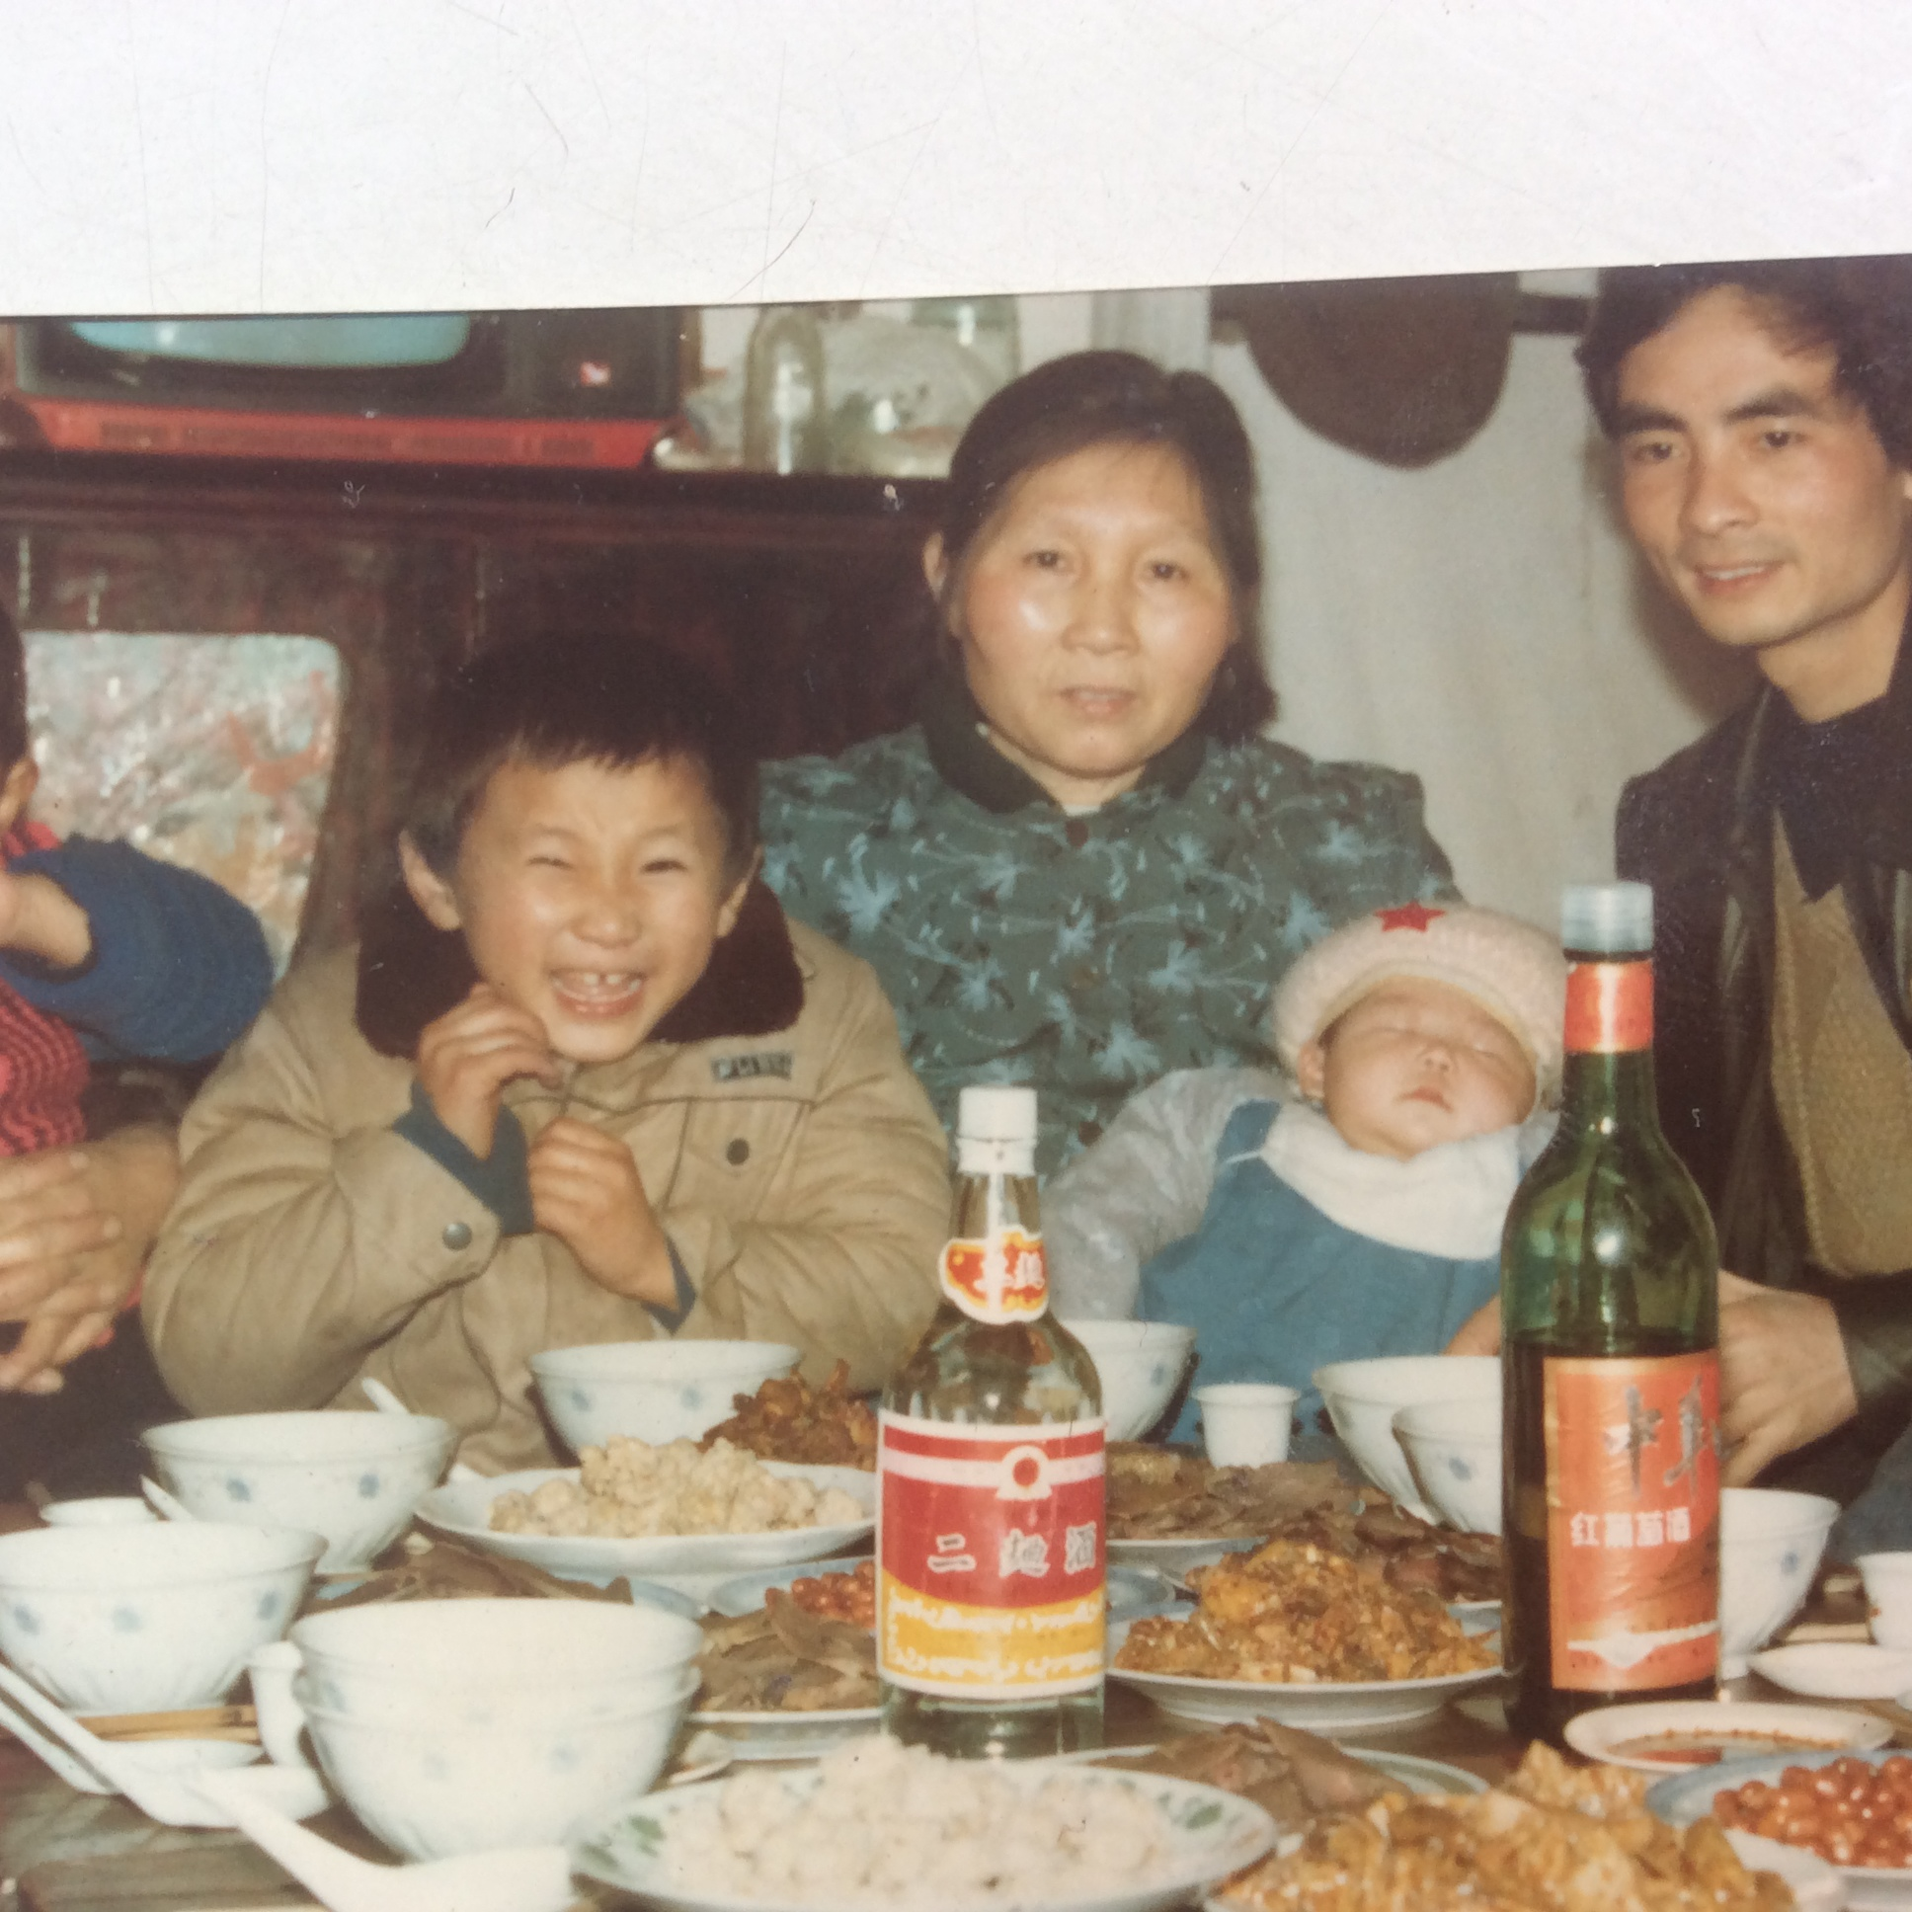
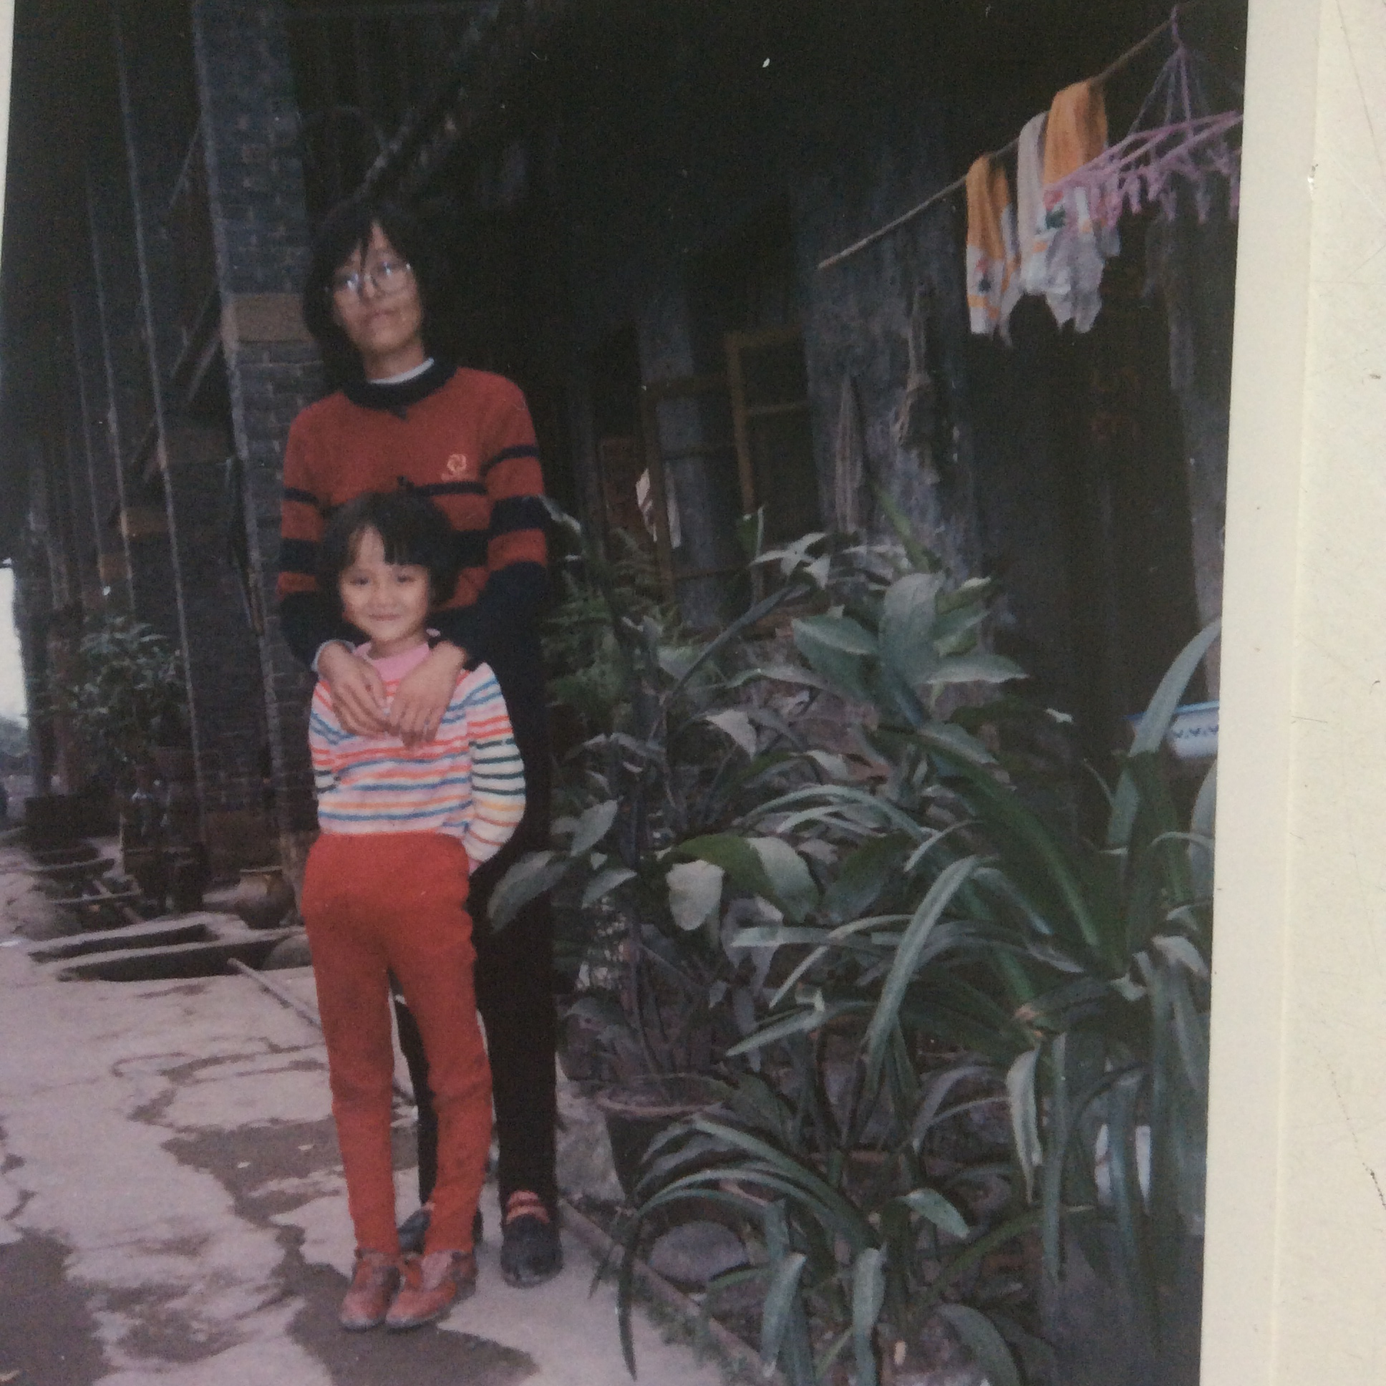
Peaceful Era, Enough Food
Peaceful Era, Enough Food
My Mom’s mother
A Farmer
My Father’s mother
A Housewife
My mother
A bookkeeper

Slide 14
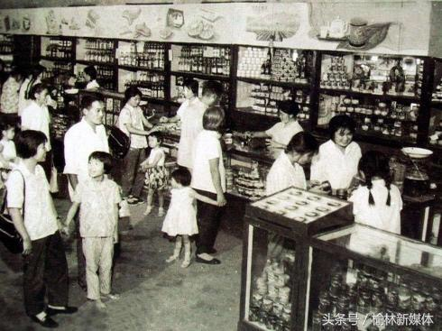
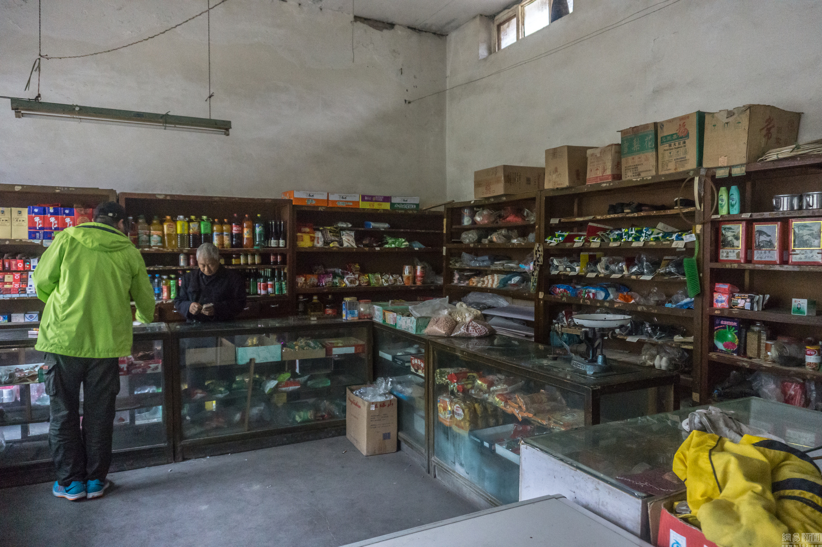
Goods Supply Center
供销社

Slide 15
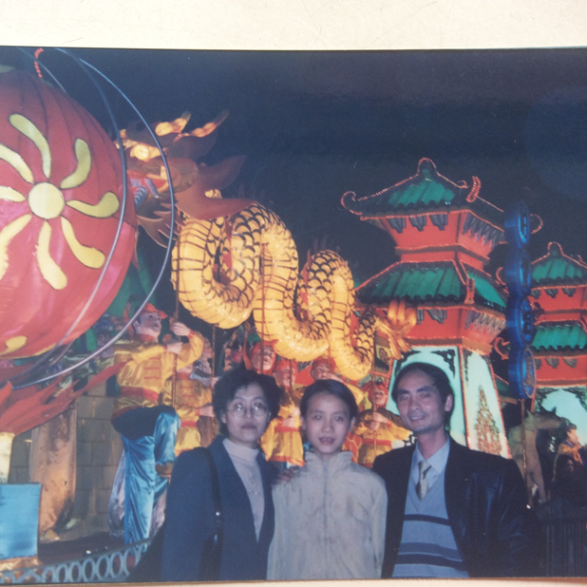
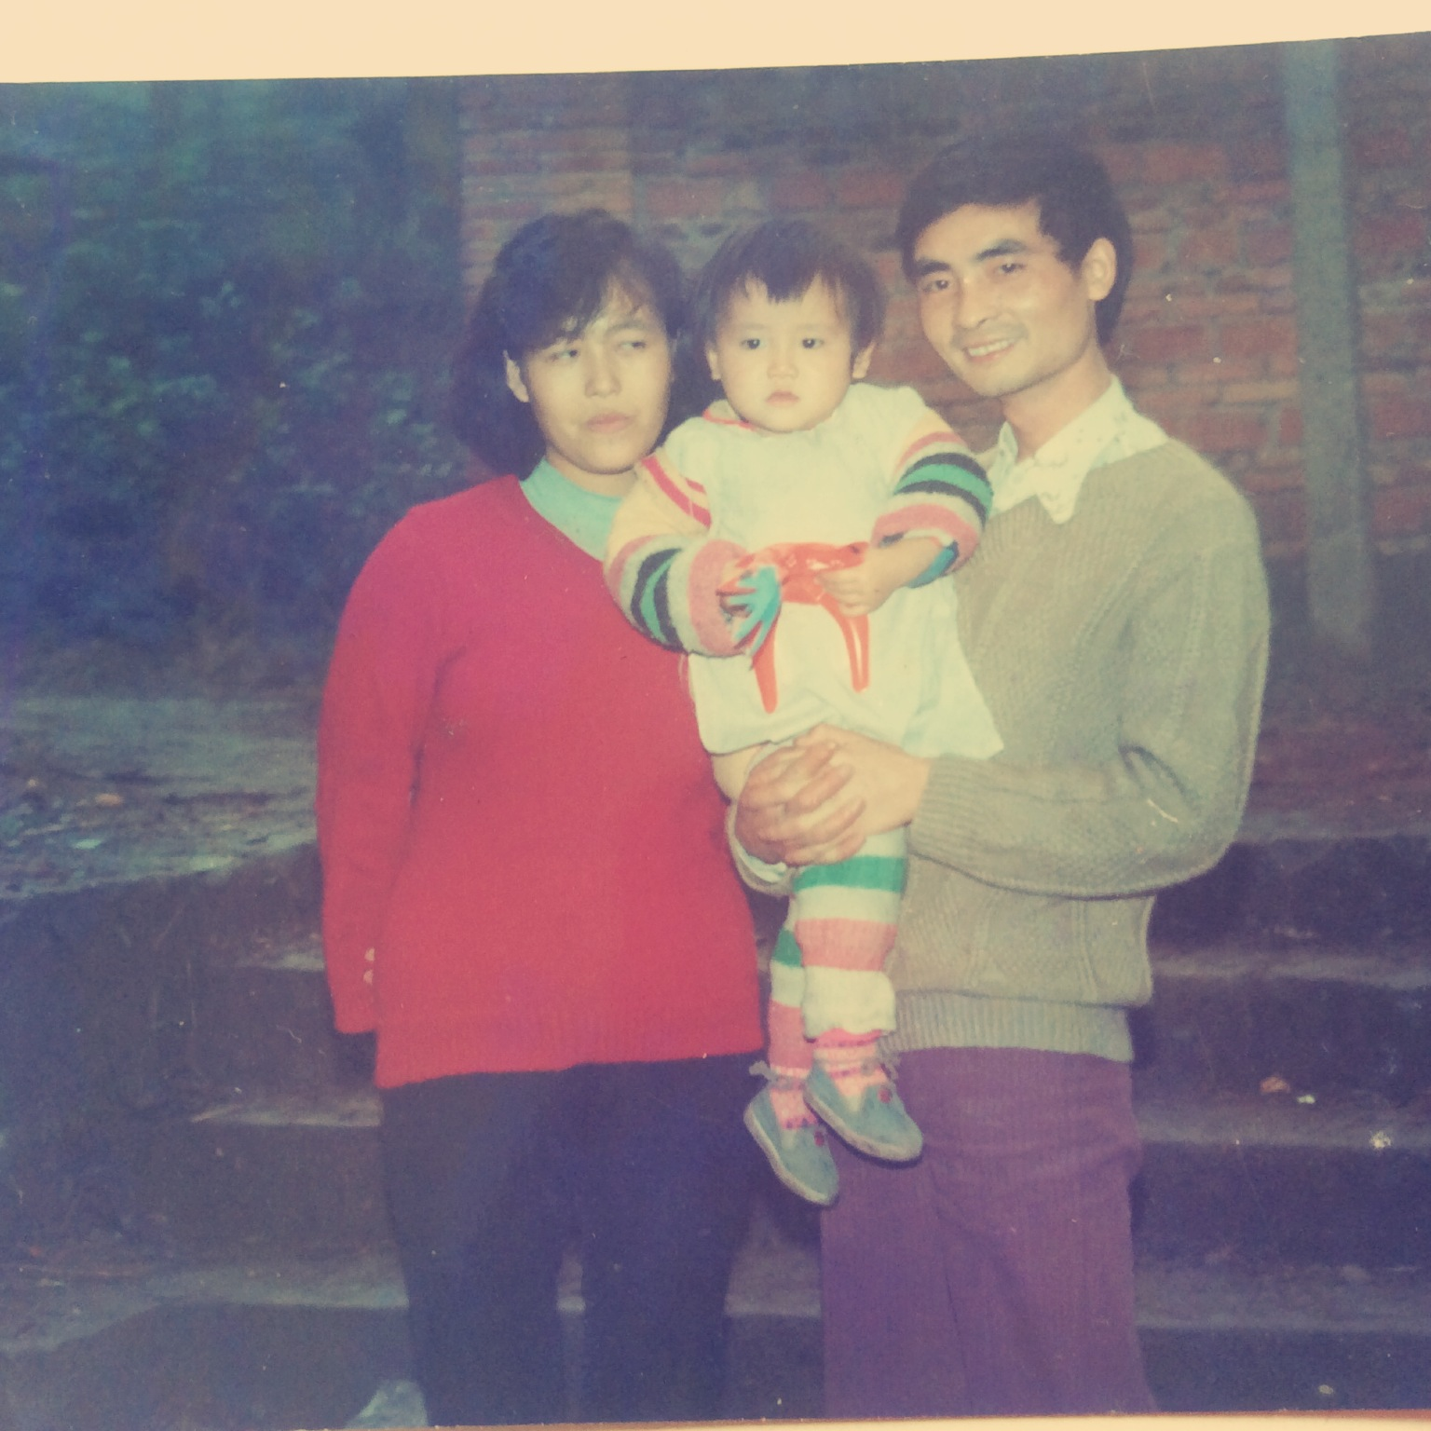
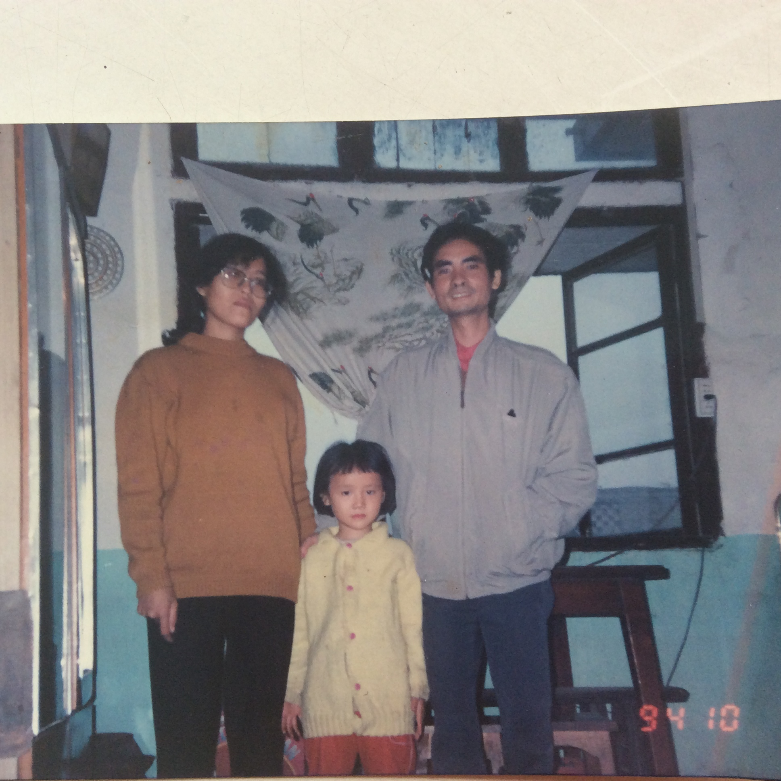
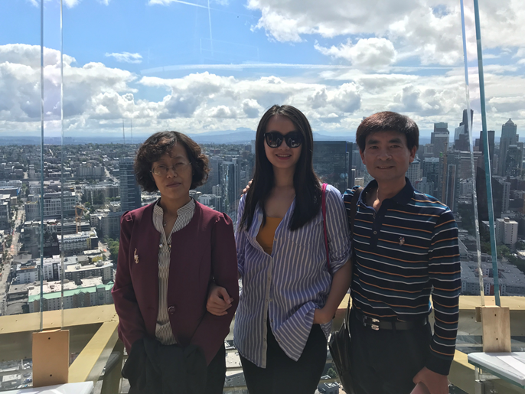
Peaceful Era, Enough Food
Better Economy , Nutrition Infrastructure, Healthcare, Education, Entertaining…
Less Information Gap: Movies, Magazines, Newspapers, TV, Internet… ----Inspired me to know how.
1994
2001
2018
1991

Slide 16
One of meanings of life for me:
We are all products of our era.
Based on the foundation laid by previous generations, We enjoy our age and develop the foundation for coming generations.
Thank You!

